Slide 1
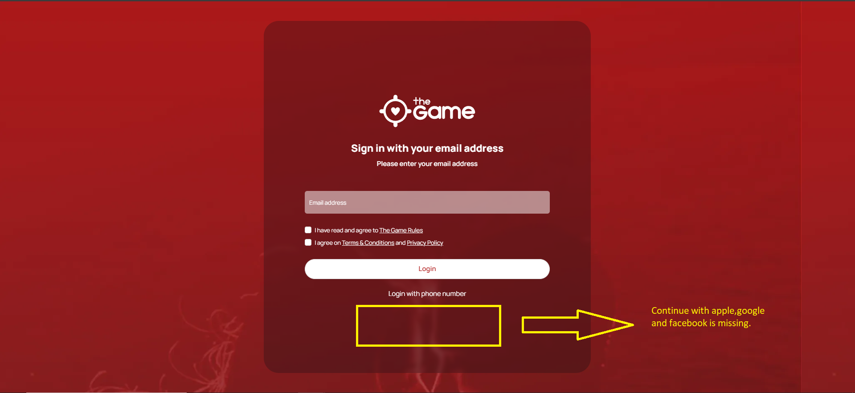

Slide 2
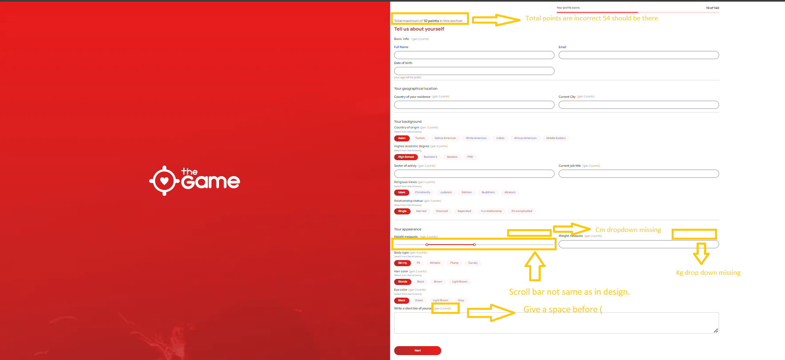
Scroll bar not same as in design
Total Points of this section still incorrect: it should be 54
Cm dropdown missing on height and weight measures field.
Please check prototype screen:
https://www.figma.com/proto/YlIenfbWOiHBOBcnz3u2xG/TheGame-FF?type=design&node-id=2051-17216&t=wKl4khqz1dRCncwj-0&scaling=scale-down&page-id=1818%3A1463&starting-point-node-id=1818%3A1483

Slide 3
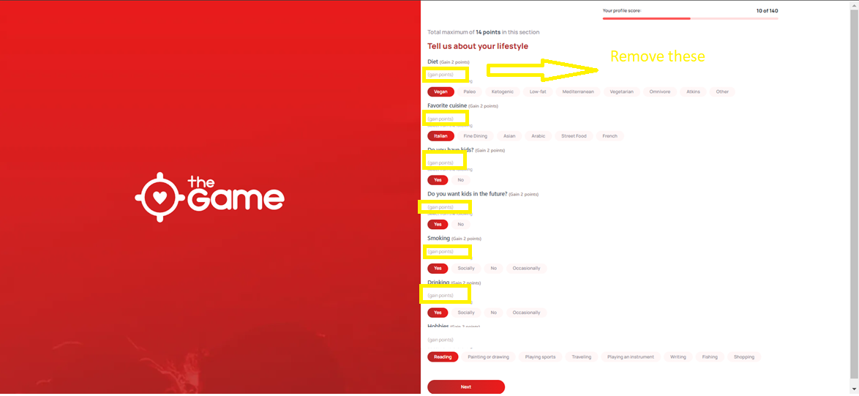
Please check prototype screen:
https://www.figma.com/proto/YlIenfbWOiHBOBcnz3u2xG/TheGame-FF?type=design&node-id=2051-17216&t=wKl4khqz1dRCncwj-0&scaling=scale-down&page-id=1818%3A1463&starting-point-node-id=1818%3A1483

Slide 4
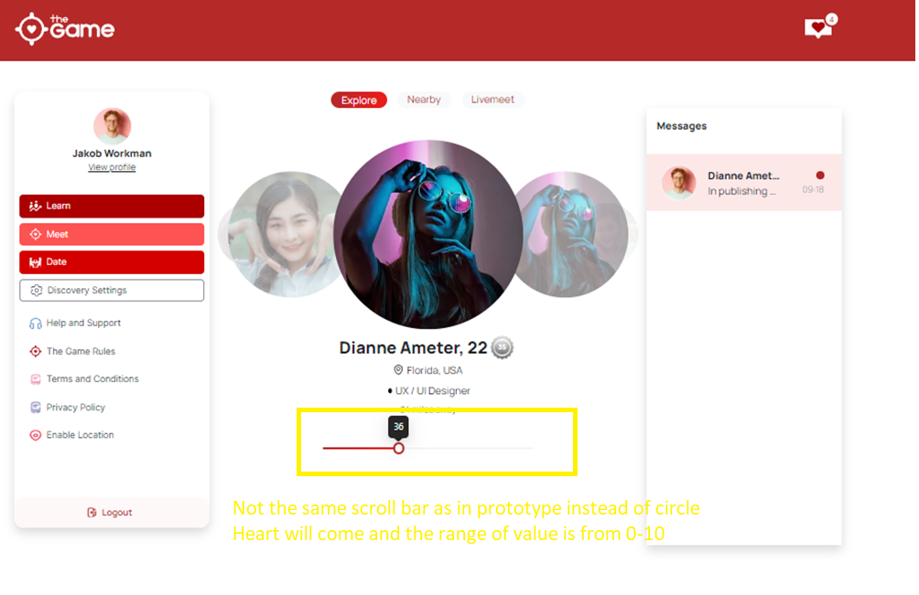
Please check prototype screen:
https://www.figma.com/proto/YlIenfbWOiHBOBcnz3u2xG/TheGame-FF?type=design&node-id=1916-50995&t=OoNT2Iv9gQ6g5CVF-0&scaling=scale-down&page-id=1818%3A1463&starting-point-node-id=1818%3A1483

Slide 5
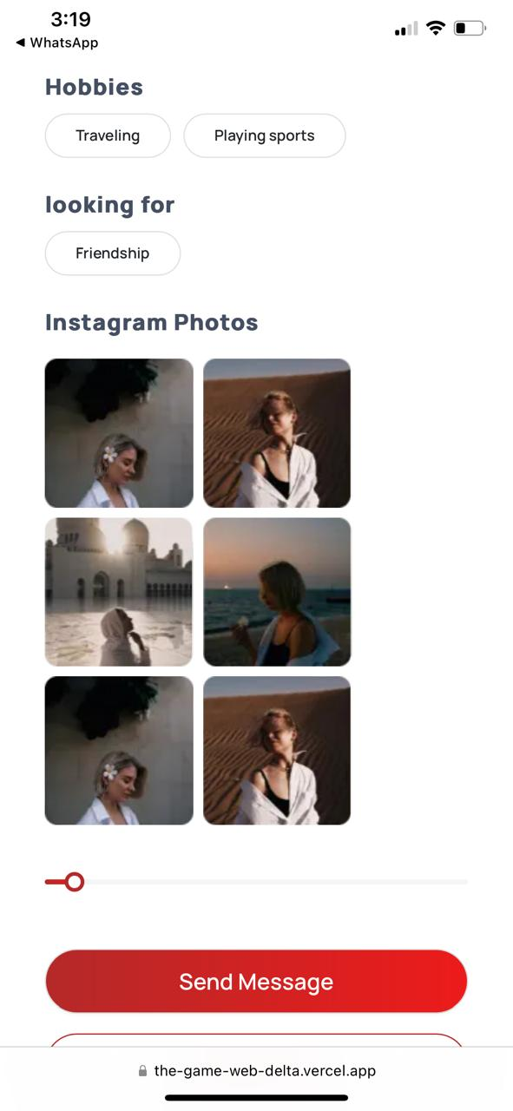
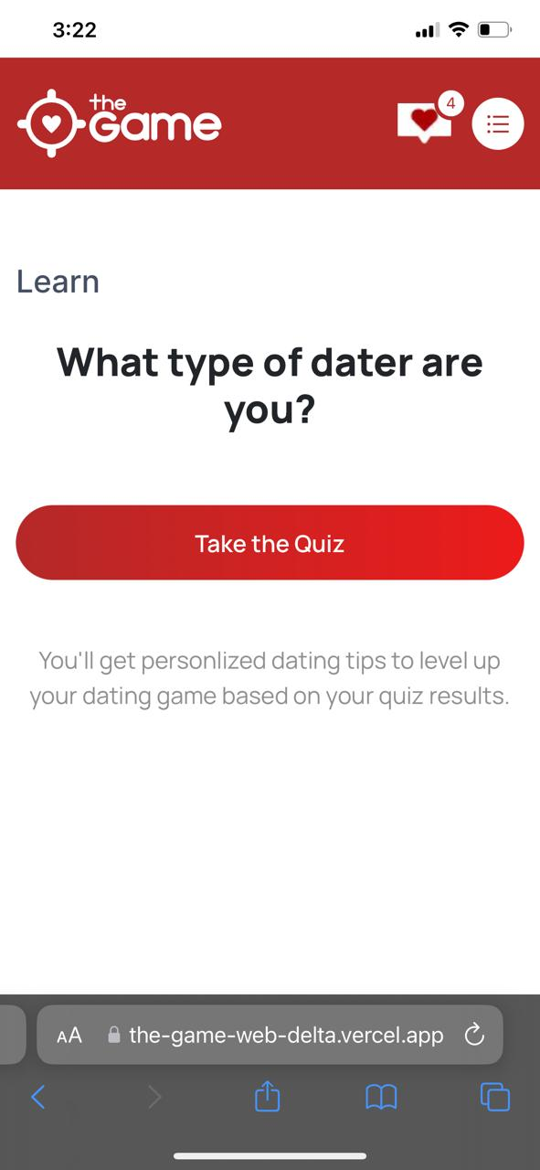
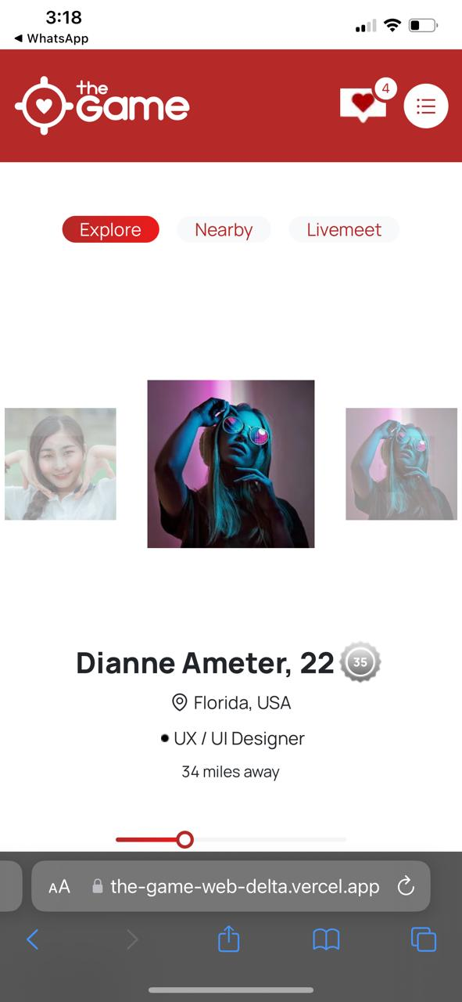
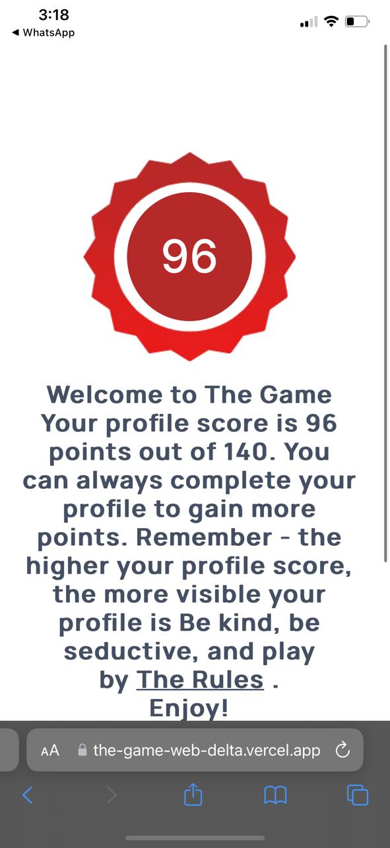
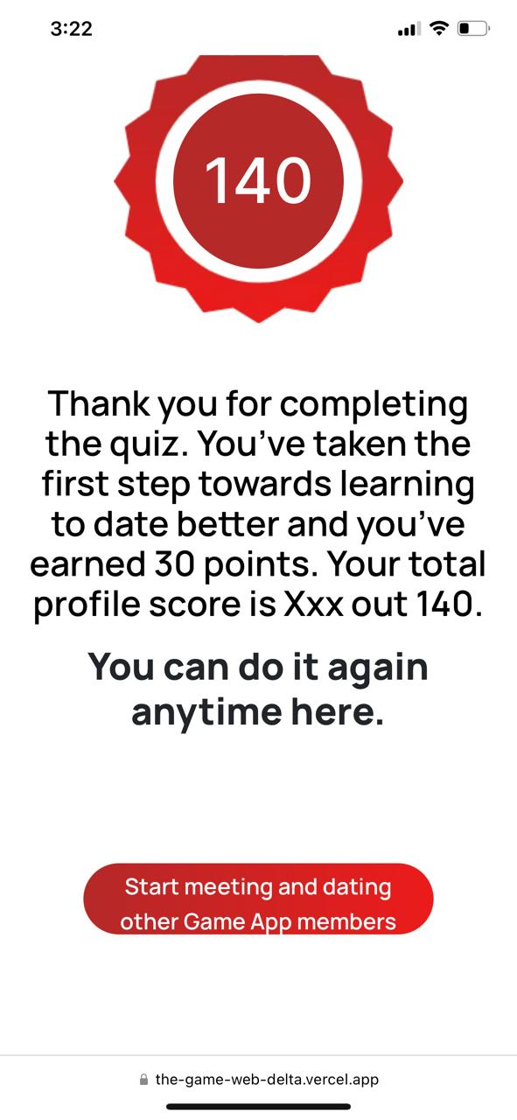
Responsive issues please compare all the screens with the mobile version screens.
Please check the mobile prototype:
https://www.figma.com/proto/YlIenfbWOiHBOBcnz3u2xG/TheGame-FF?type=design&node-id=1-515&t=6fqpbhVCDIXGdP61-0&scaling=scale-down&page-id=0%3A1&starting-point-node-id=1%3A499

Slide 6
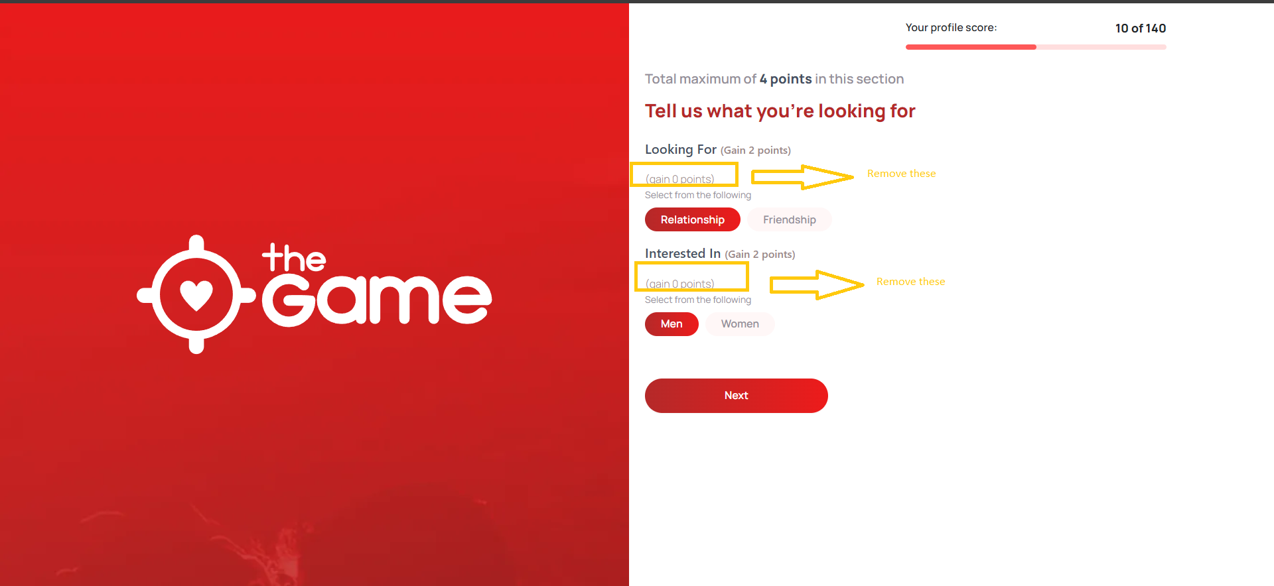
Please check prototype screen:
https://www.figma.com/proto/YlIenfbWOiHBOBcnz3u2xG/TheGame-FF?type=design&node-id=2071-22457&t=OoNT2Iv9gQ6g5CVF-0&scaling=scale-down&page-id=1818%3A1463&starting-point-node-id=1818%3A1483

Slide 7
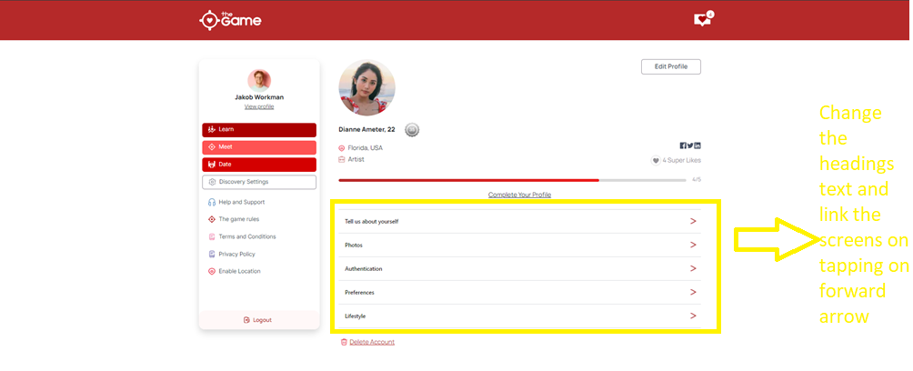
Please check prototype screen:
https://www.figma.com/proto/YlIenfbWOiHBOBcnz3u2xG/TheGame-FF?type=design&node-id=1862-20110&t=wKl4khqz1dRCncwj-0&scaling=scale-down&page-id=1818%3A1463&starting-point-node-id=1818%3A1483

Slide 8
General Notes
Not opening the discovery settings on tapping on discovery screen please create the screen with static values.
Not opening notifications pop over. Just display static UI of it.

Slide 9
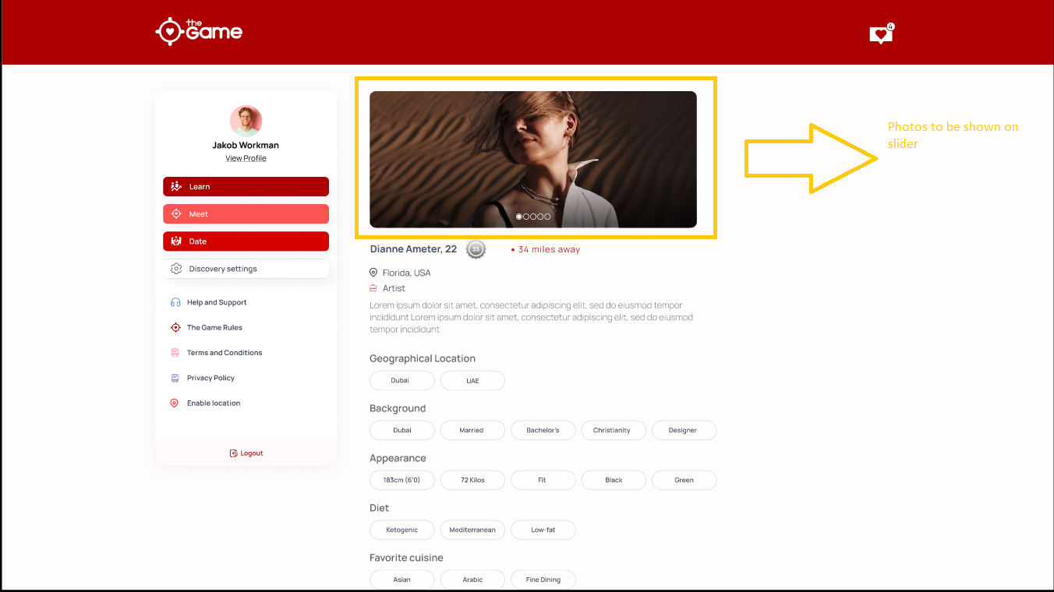
Please check prototype screen:
https://www.figma.com/proto/YlIenfbWOiHBOBcnz3u2xG/TheGame-FF?type=design&node-id=1916-50995&t=OoNT2Iv9gQ6g5CVF-0&scaling=scale-down&page-id=1818%3A1463&starting-point-node-id=1818%3A1483

Slide 10
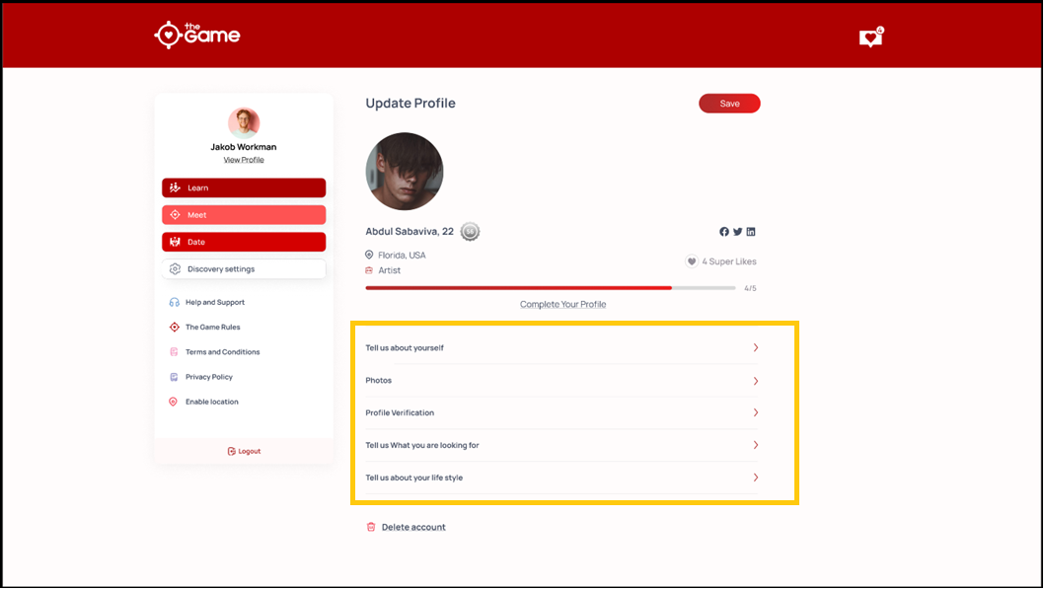
No back button from these options

Slide 11
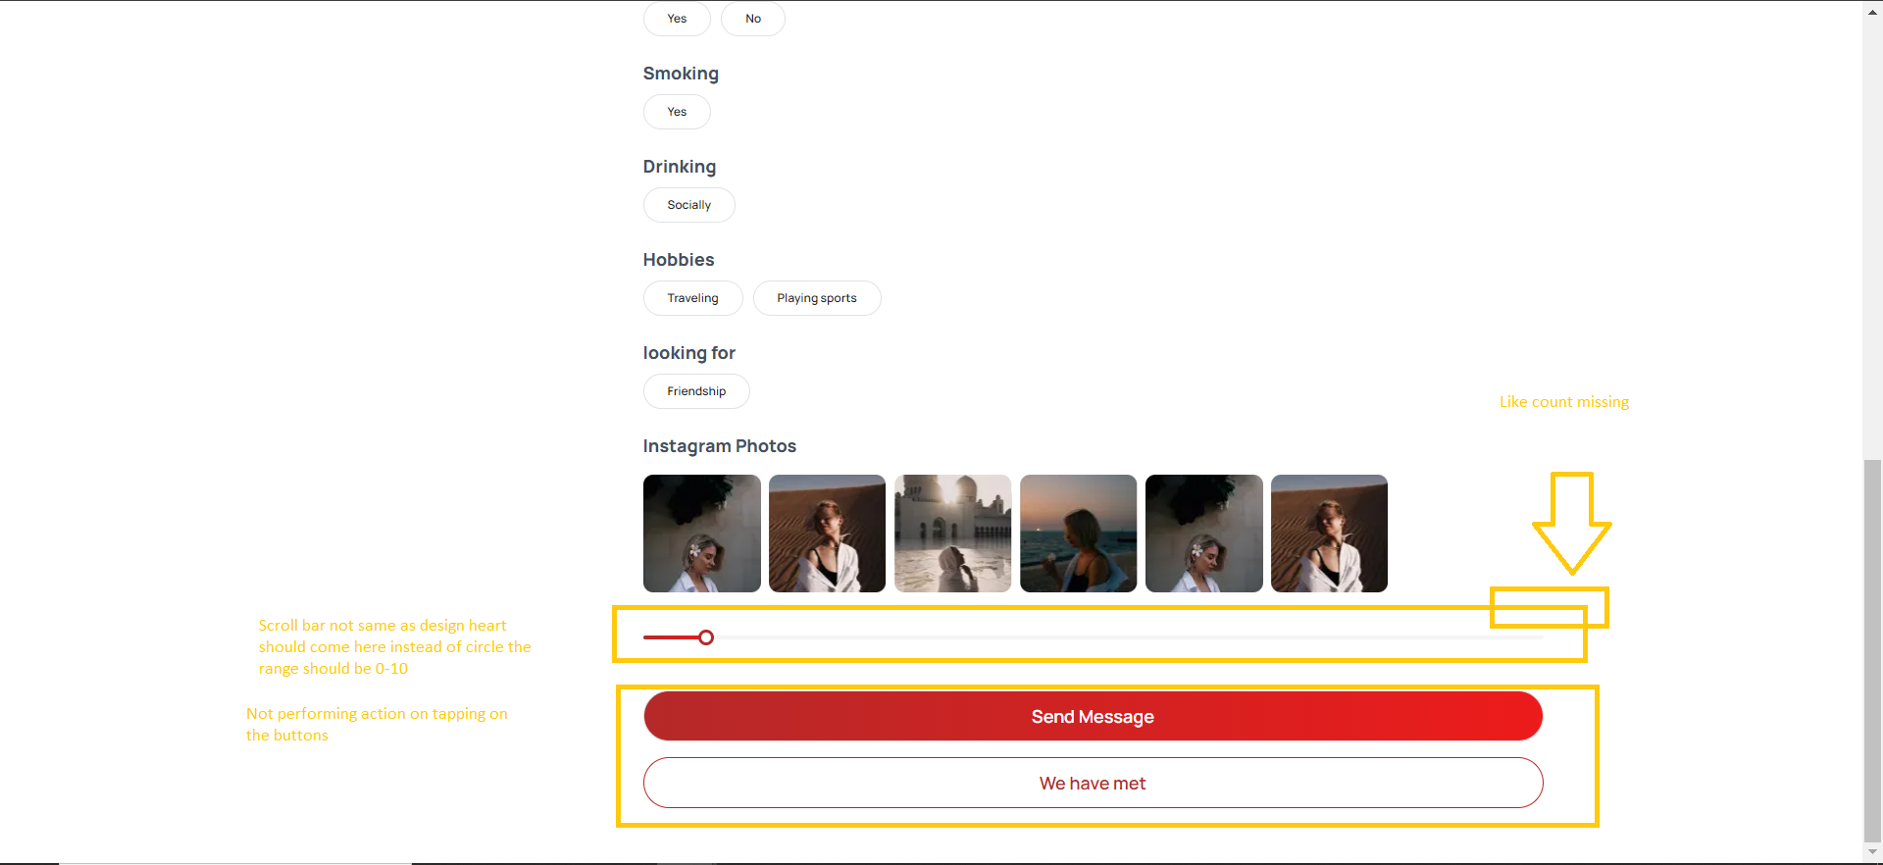
Please check prototype:
https://www.figma.com/proto/YlIenfbWOiHBOBcnz3u2xG/TheGame-FF?type=design&node-id=2136-28354&t=OoNT2Iv9gQ6g5CVF-0&scaling=scale-down&page-id=1818%3A1463&starting-point-node-id=1818%3A1483

Slide 12
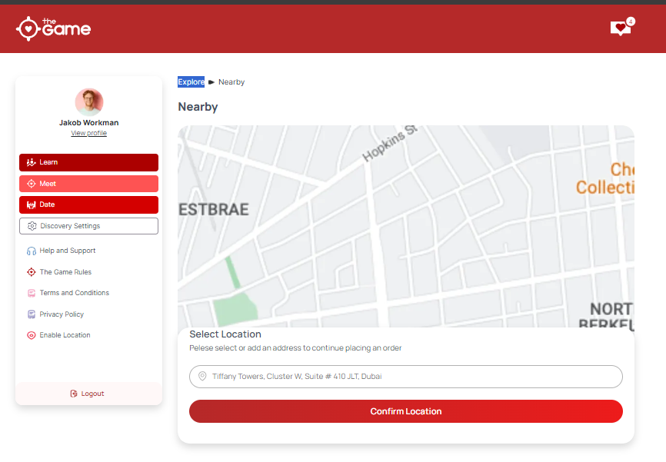
Not opening meet screen on tapping on explore:
Please check prototype:
https://www.figma.com/proto/YlIenfbWOiHBOBcnz3u2xG/TheGame-FF?type=design&node-id=1904-36495&t=OoNT2Iv9gQ6g5CVF-0&scaling=scale-down&page-id=1818%3A1463&starting-point-node-id=1818%3A1483

Slide 13
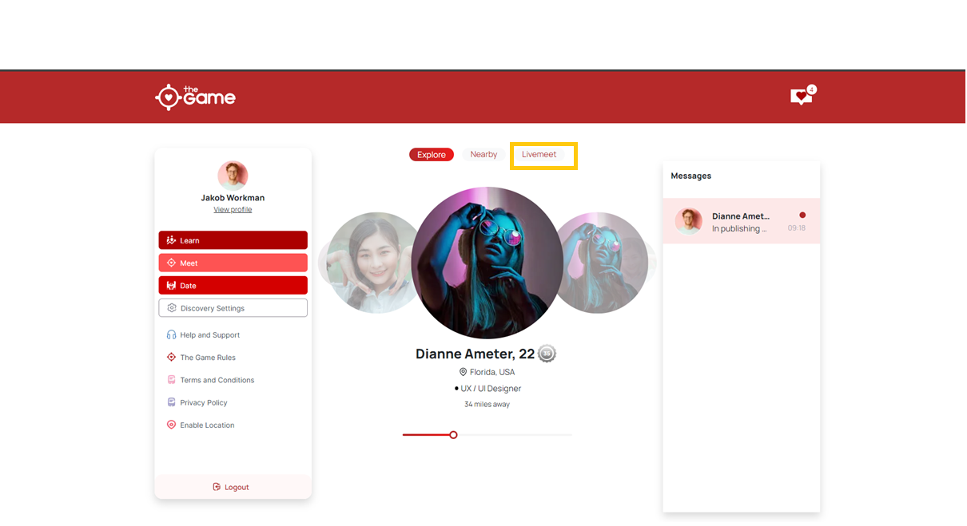
There should be space between Live Meet text.

Slide 14
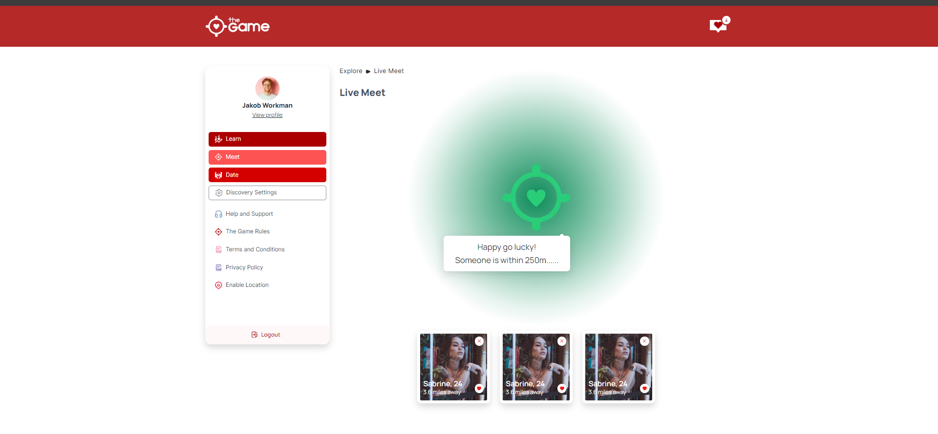
Enable live meet button missing
Please check prototype:
https://www.figma.com/proto/YlIenfbWOiHBOBcnz3u2xG/TheGame-FF?type=design&node-id=2014-4723&t=OoNT2Iv9gQ6g5CVF-0&scaling=scale-down&page-id=1818%3A1463&starting-point-node-id=1818%3A1483

Slide 15
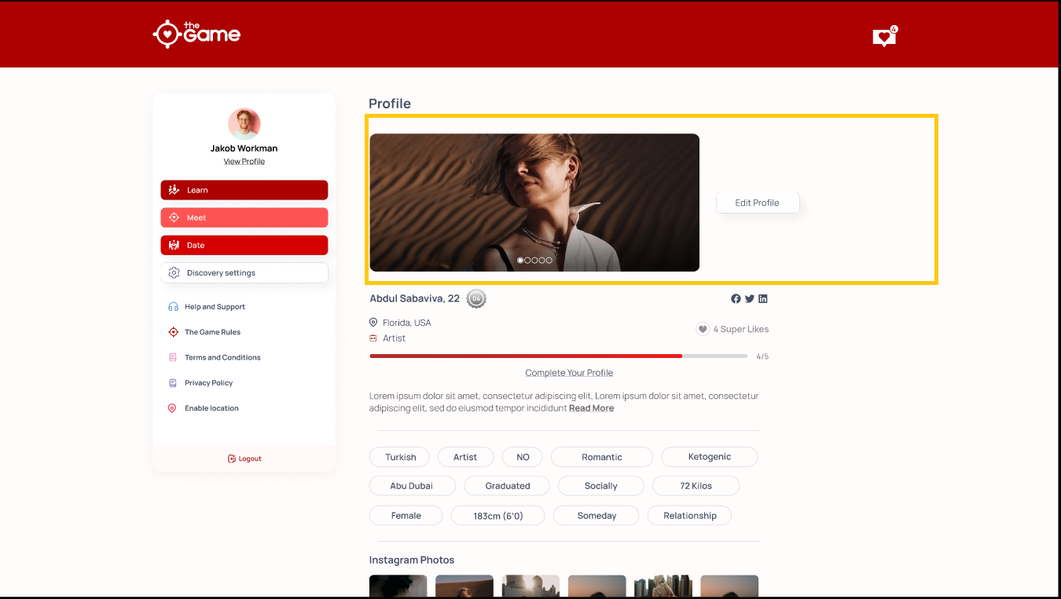
Profile Images section to be updated it should be appearing in same way as shown in the profile
Link:
https://www.figma.com/proto/YlIenfbWOiHBOBcnz3u2xG/TheGame-FF?type=design&node-id=1862-19645&t=OoNT2Iv9gQ6g5CVF-0&scaling=scale-down&page-id=1818%3A1463&starting-point-node-id=1818%3A1483

